Slide 1
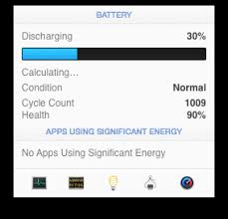
APPROACHES
CONCEPTS OF BATTERY MANAGEMENT SYSTEM (BMS)
Monitoring
Maintenance
Battery Charge
End user(sync with BMS APP)

Slide 2

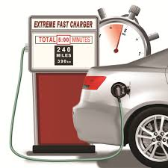

MAINTENANCE UNIT
HOW LONG THE BATTERY LAST??
WHAT WILL BE CONDITION OF BATTERY??
WHAT IS THE BATTERY’S LIFE??

Slide 3
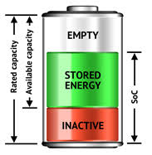
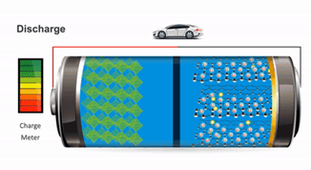
CONDITION OF BATTERY
PARAMETERS
State of health (SOH)
State of charge(SOC)
Depth of discharge(DOD)
Load size
Temperature
Ageing factor

Slide 4
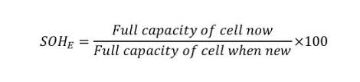

STATE oF HEALTH
SOH- is a figure of merit of the condition of a battery compared to its ideal conditions. The units of SoH are percent points (100% = the battery's conditions match the battery's specifications). Typically, a battery's SoH will be 100% at the time of manufacture and will decrease over time and use.
25%
50%
75%
100%

Slide 5

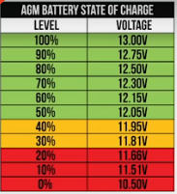
State OF CHARGE & depth of discharge
State of charge (SoC) is the level of charge of an electric battery relative to its capacity. The units of SoC are percentage points (0% = empty; 100% = full).
An alternative form of the same measure is the Depth of discharge (DoD)the inverse of SoC (100% = empty; 0% = full).
SoC is normally used when discussing the current state of a battery in use, while DoD is most often seen when discussing the lifetime of the battery after repeated use.
Other battery may have slight differences

Slide 6
LIFE OF BATTERY
DETERMINATION OF ENERGY CYCLE COUNT
The energy cycle which is the process of charging a rechargeable and discharging it as required into a load and typically used to specify the battery’s expected life.
SCENARIO 1 (100%-0%)
In this scenario, the energy cycle (100%-0%) which means we can complete one charge cycle when we used or discharged the same amount that equals100% of our battery’s capacity
SCENARIO 2 (Varying level)
It is not necessary to discharge all from one charge ,for instance we might use 75% of our battery’s capacity ,then recharge it fully overnight ,next day if we use 25% then we will have discharge of total 100% that means the two days will add up to one charge cycle or one energy cycle

Slide 7
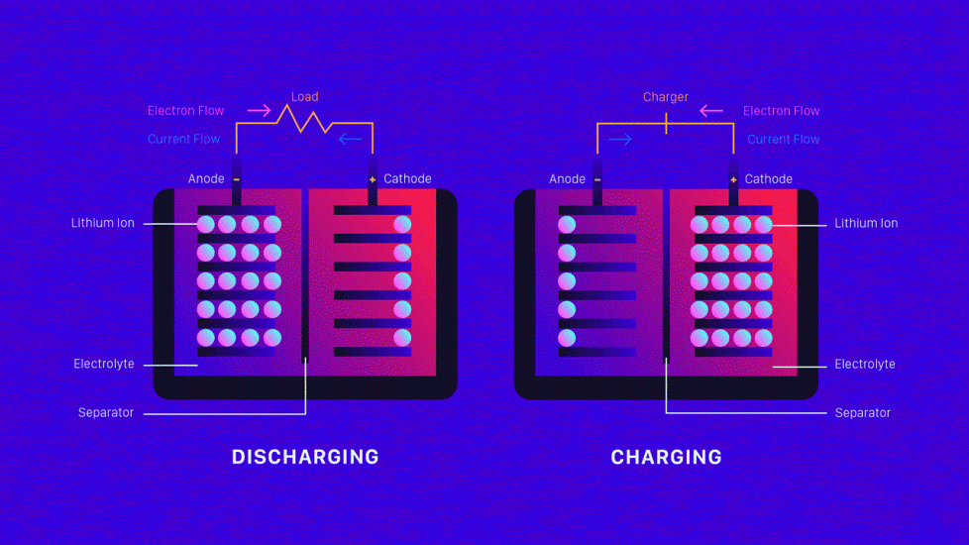
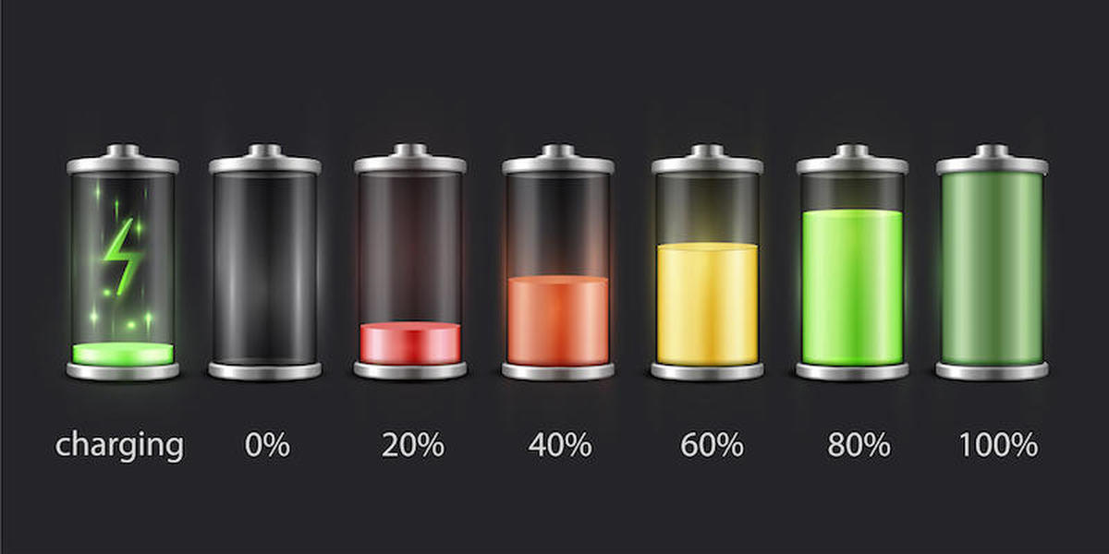
representation
DAY 1-80% CHARGED
DAY 2-20% CHARGED
ENERY CYCLE COUNT=0.8+0.2
=1 cycle count
then sum of these data will be equal to 1 energy cycle or else if we charge to 40% then it is equal to 1.2 energy cycle count will be over from the total

Slide 8
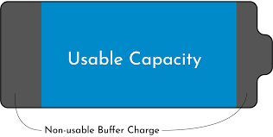
BATTERY LIFE DEGRADATION
Capacity of Battery(COB) Initial period
CONSIDERATION:
Input- 12V 100Ah
Pack voltage-144V(12*12V)
COB=Ah*V
=100Ah*144V
=14400Wh /14.4kWh
Capacity of Battery(COB) after 2 years usage
CONSIDERATON:
Input=12V 100Ah
Pack voltage=144V
External factor=0.70(temperature , ageing issues)
COB=Ah*V*0.70
=100Ah*144V*0.70
=10080Wh / 10.080kWh

Slide 9
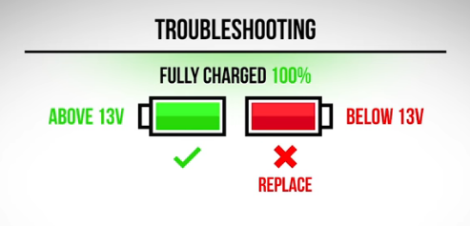

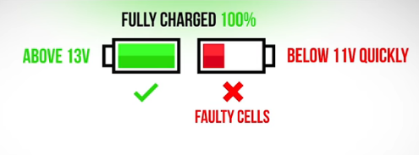



Testing and service
To test the battery package
Test each battery separately that disconnect from other batteries
Test voltage level equipment
MULTIMETER
VOLTMETER
WATTMETER
Vehicle driven in hot temperature shows faster decline in battery SoH
Higher battery life achieved by lowering load current
Minimize fast charging
BATTERY DEAD

